Slide 1
NLP unsupervised learning:
Message classification for disaster response
METIS BOOTCAMP | July 23, 2021
Presented by: Kalu Uga

Slide 2
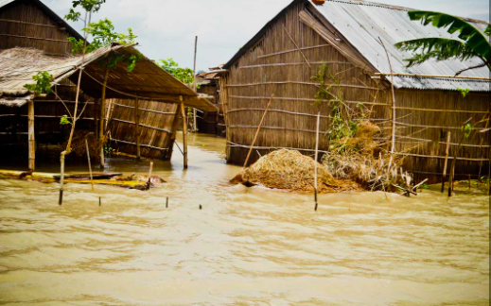
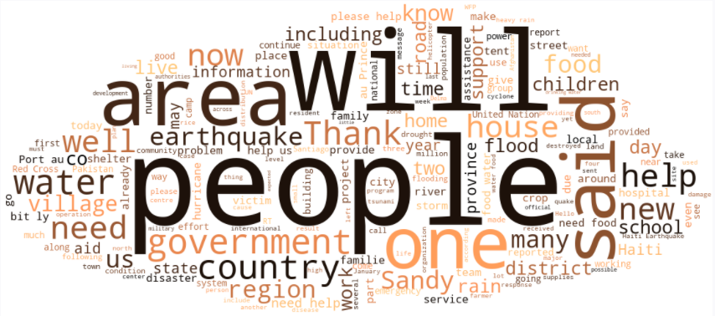
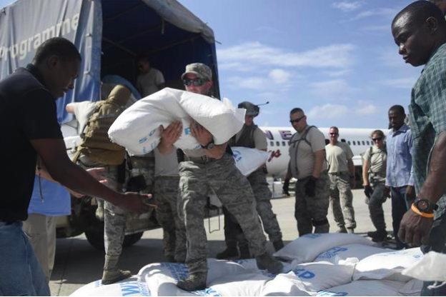
Problem statement
Use topic modeling to group disaster messages and predict the group where a new message belong.

Slide 3
Dataset
Earthquake in Haiti in 2010
Earthquake in Chile in 2010
Floods in Pakistan in 2010
Super-Storm Sandy in the US in 2012
News articles from different disasters
Original Message
+
English Translation
30,000
Messages

Slide 4







WORKFLOW

Slide 5
Preprocessing
Clean Documents
Tokenization
Lemmatization
Vectorizer
Cut off words that occurs in less than 10 documents
Cut off words that occur in more than 50% of document

Slide 6
MODElS
CountVectorizer + LatentDirichletAllocation
TfidfVectorizer + LatentDirichletAllocation - Best topic interpretation
CountVectorizer + TruncatedSVD
TfidfVectorizer + TruncatedSVD
CountVectorizer + NMF
TfidfVectorizer + NMF

Slide 7
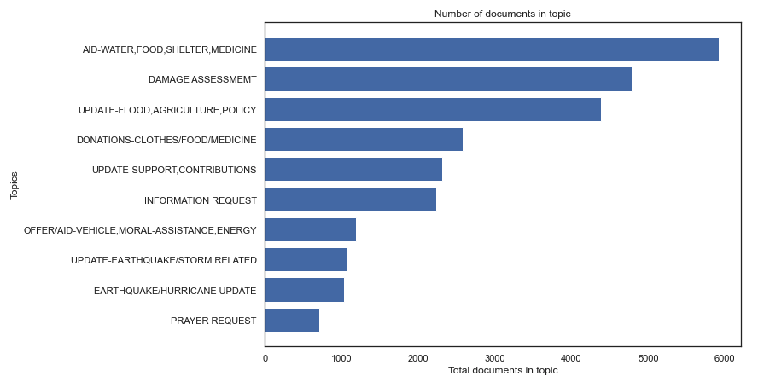
Tfidf + LDA - topics (10 topics, 15 keywords)

Slide 8
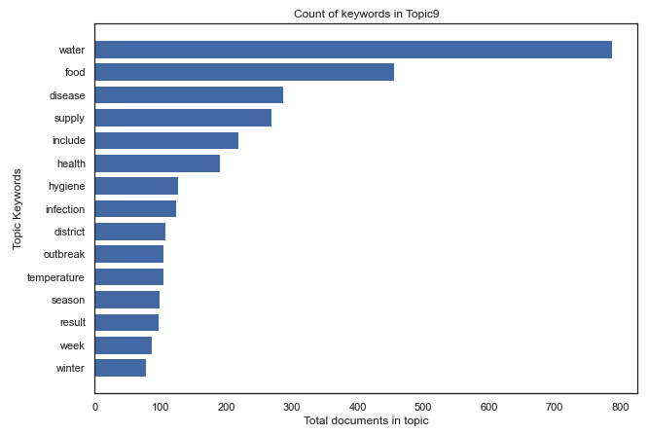
Tfidf + LDA - keywords in topic9
Donations - Clothes, Food, Medicine, Water

Slide 9
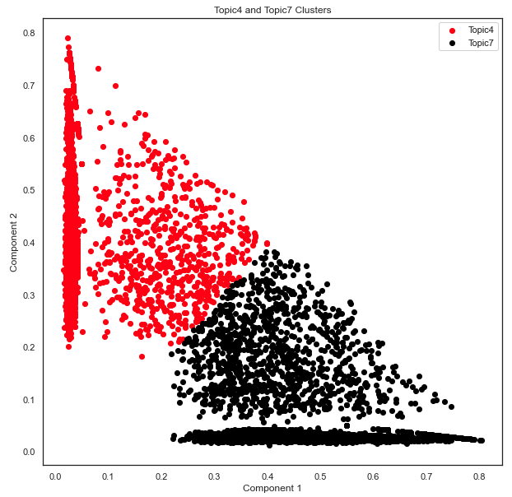
filtered cluster - topic4 and topic7

Slide 10
Prediction and most similar message
Message Example
["We need food and medical suppies. The kids also need blankets and clothing"]
Predicted group
Aid -Water, Food, Shelter, Medicine
Most Similar Message - Cosine Similarity
we have clothes for all ages and brand new shoes and boots we have baby items like diapers car seats high chair ect we also have hygine products like wipes toothbrushes toothpaste ect we also have some kids toys and stuffed animals even a bike and we also have some non perishable foods and blankets

Slide 11
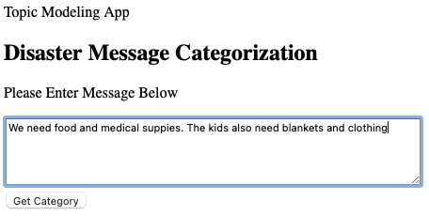
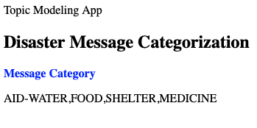
Prediction - flask app

Slide 12
Recommendations
Tfidf + LDA provides clear interpretation of topics for a mixture of short and long messages.
Tfidf + LDA can find topics that other algorithms will miss.

Slide 13
APPENDIX - Tfidf + LDA - topics
Using 10 topics and 15 keywords
Update - Flood, Agriculture
Update - Support, Contributions
Aid - Water, Food, Shelter, Medicine
Prayer Request
Damage Assessment
Update - Earthquake, Storm Related
Offer/Aid - Vehicle, Moral Assistance, Energy
Information Request
Earthquake/Hurricane Update
Donations - Clothes, Food, Medicine, Water

Slide 14
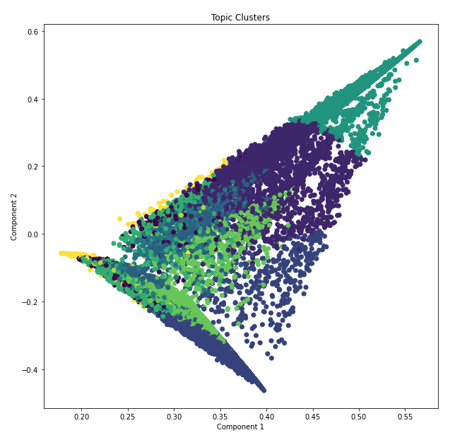
APPENDIX - Tfidf + LDA - clusters

Slide 15
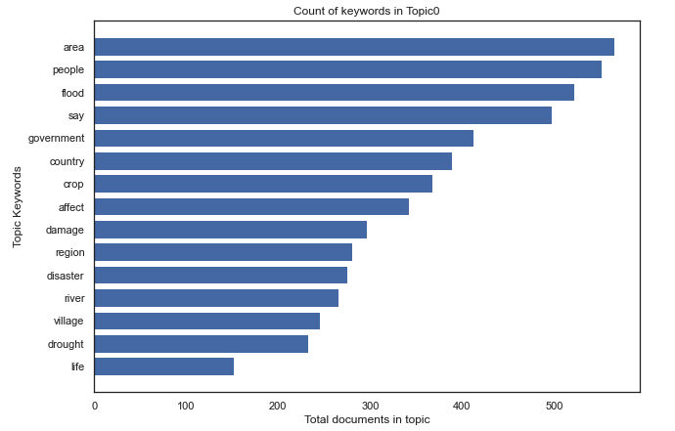
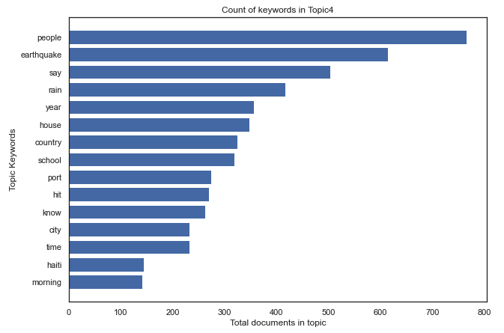
APPENDIX - Tfidf + LDA - Topic0/Topic4

Slide 16
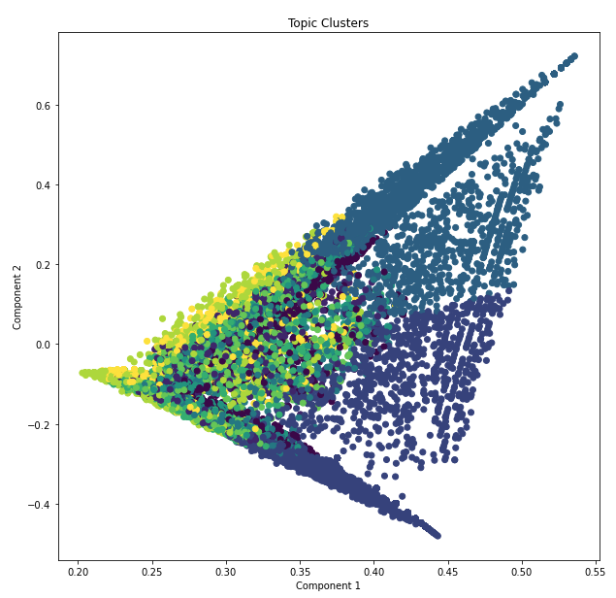
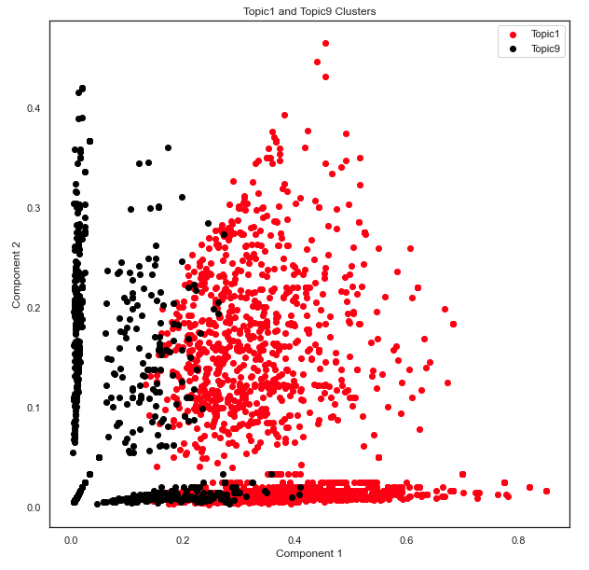
APPENDIX - CV + LDA - clusters

Slide 17
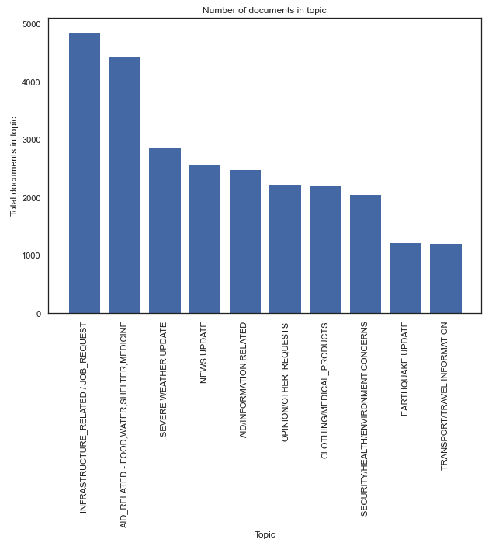
APPENDIX - CV + LDA - topic/doc count

Slide 18
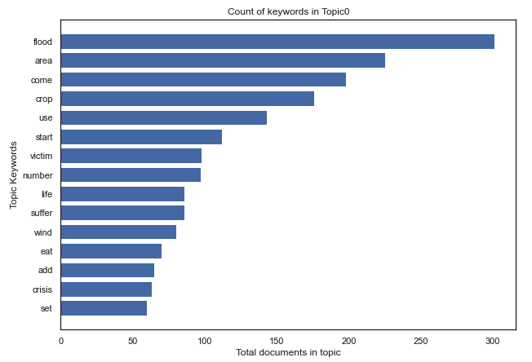
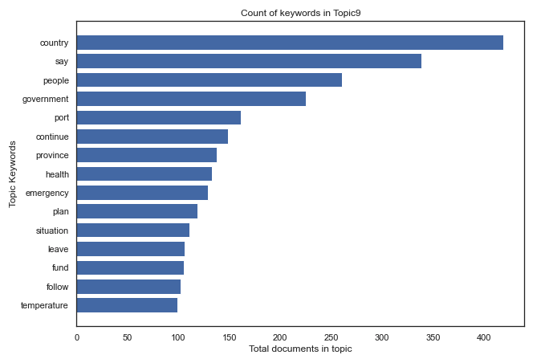
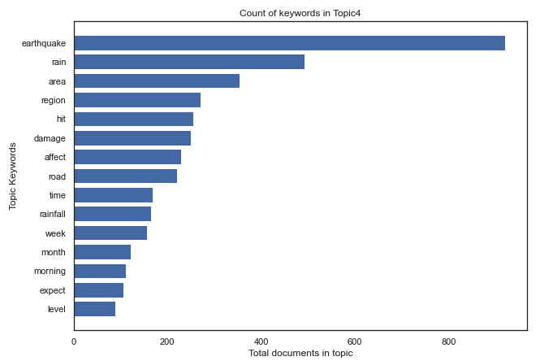
APPENDIX - CV + LDA - topic0/topic4/topic9

Slide 19
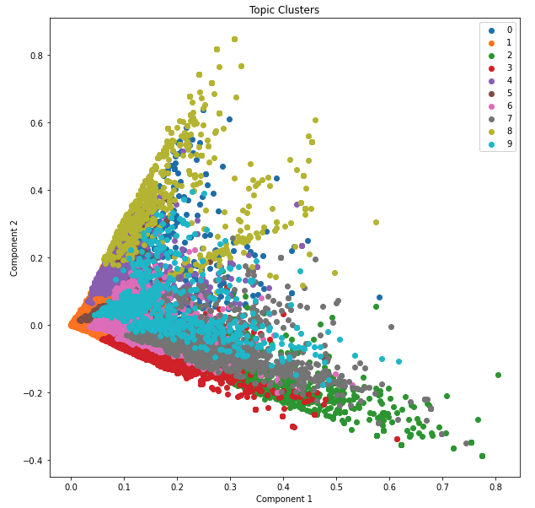
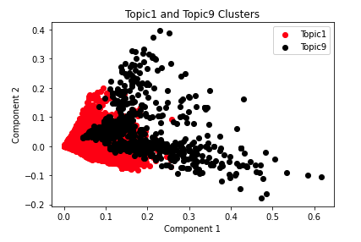
APPENDIX - tfidf + LsA - clusters

Slide 20
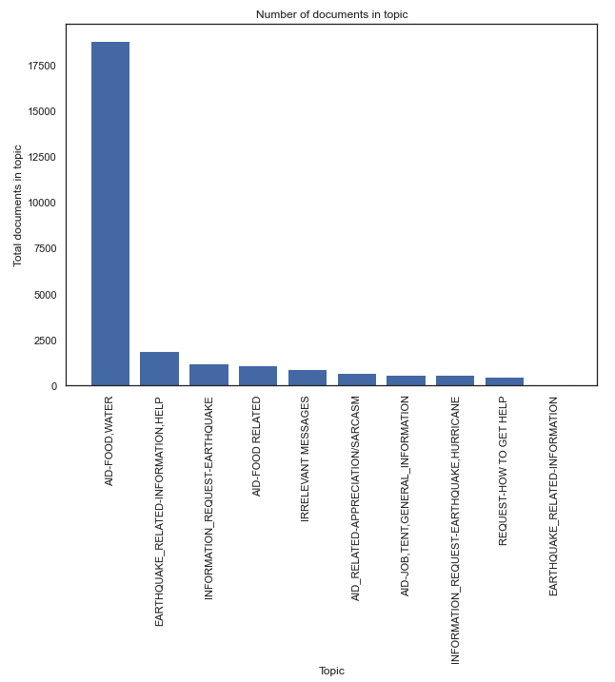
APPENDIX - TFIDF + LSA - topic/doc count

Slide 21
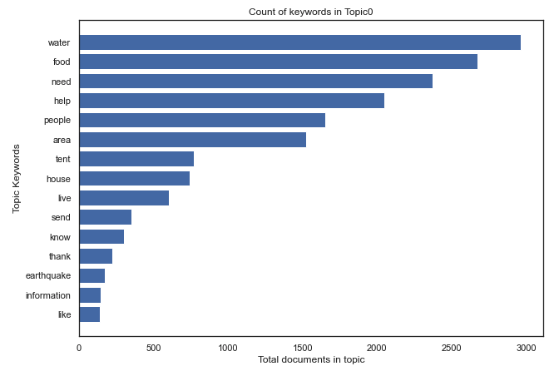
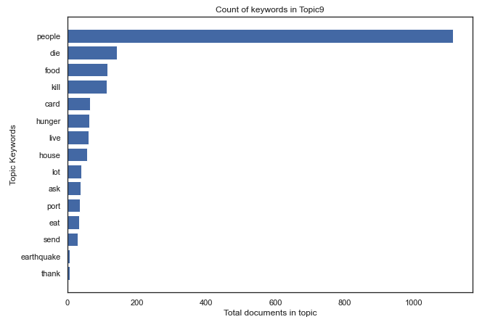
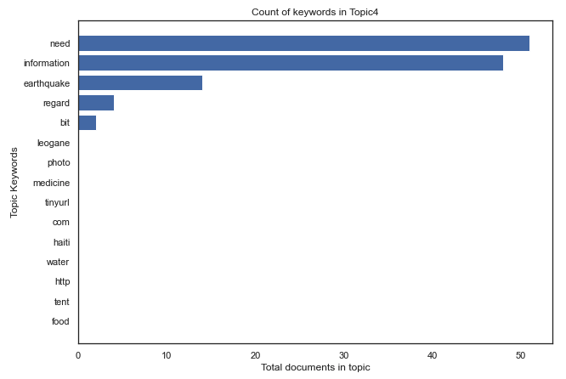
APPENDIX - tFIDf + LsA - topic0/topic4/topic9

Slide 22
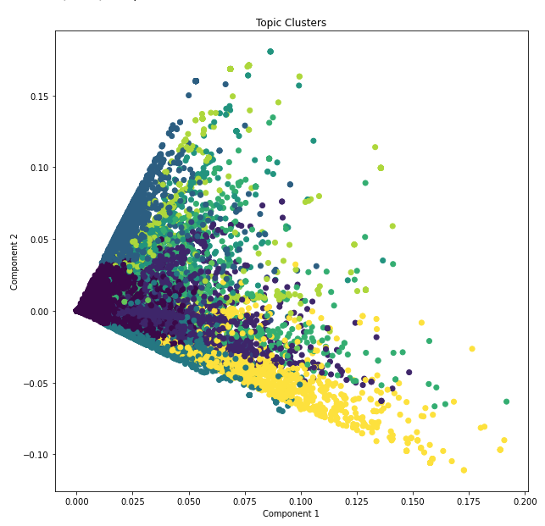
APPENDIX - tfidf + NMF - clusters

Slide 23
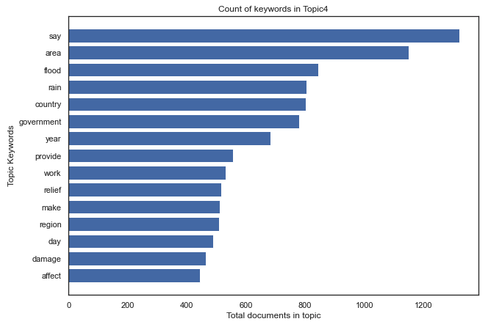
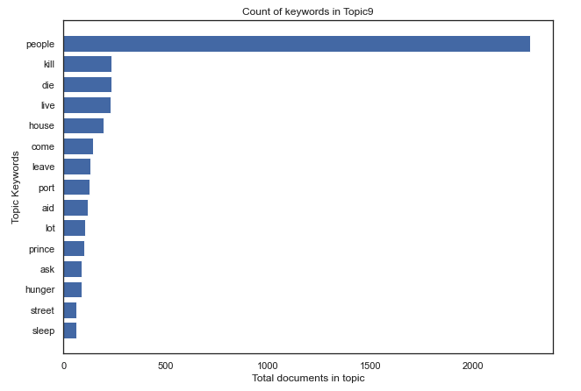
APPENDIX - tFIDf + NMF - topic4/topic9

